Slide 1
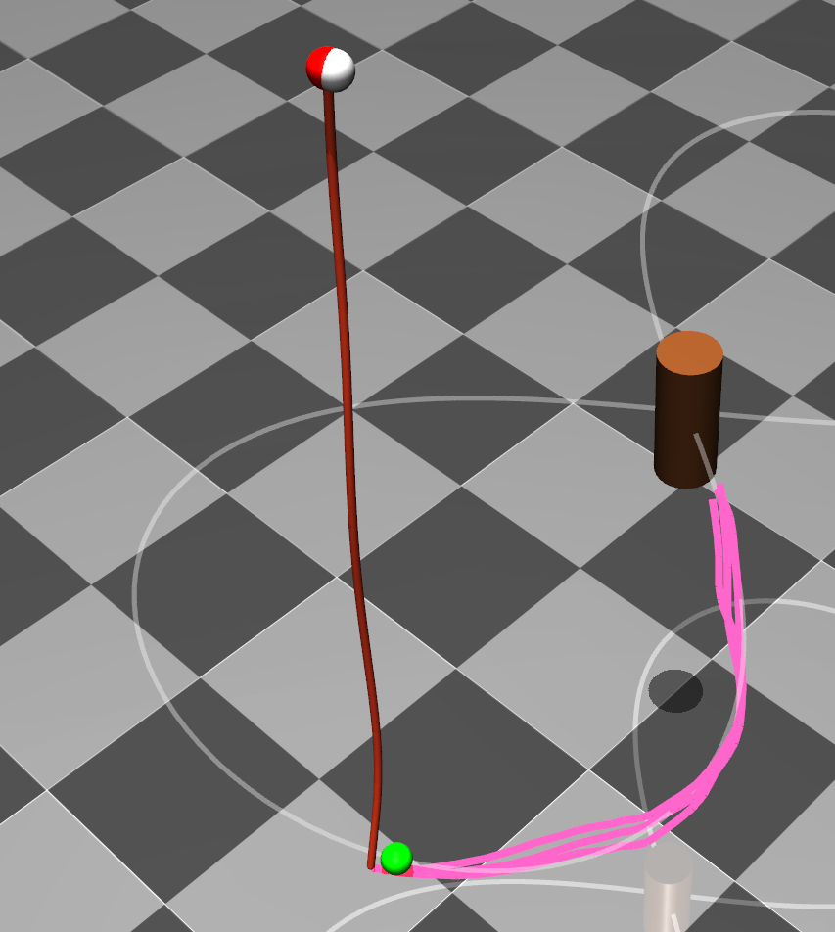
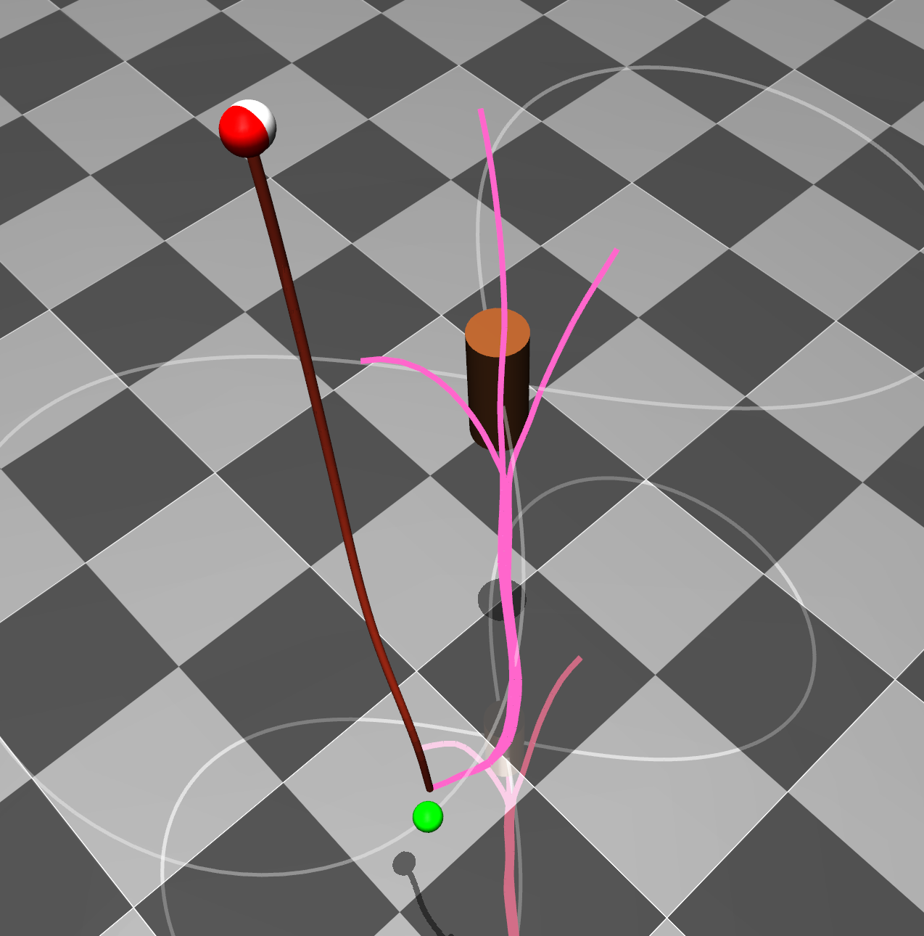
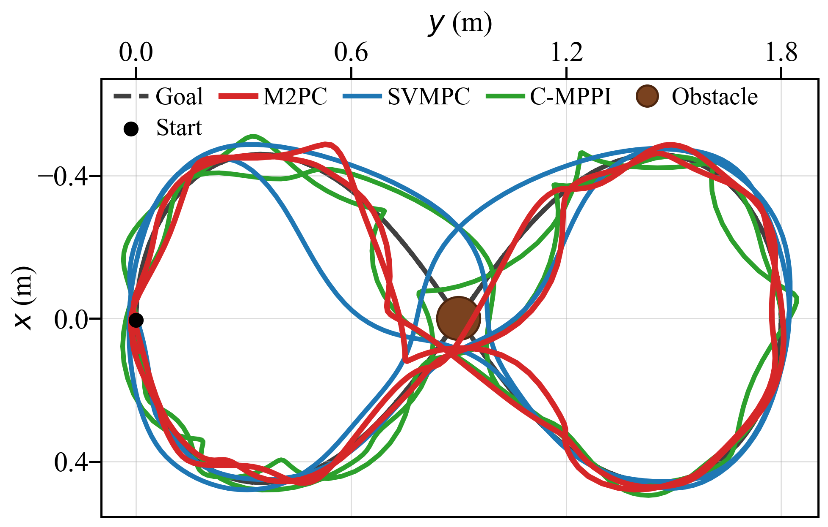
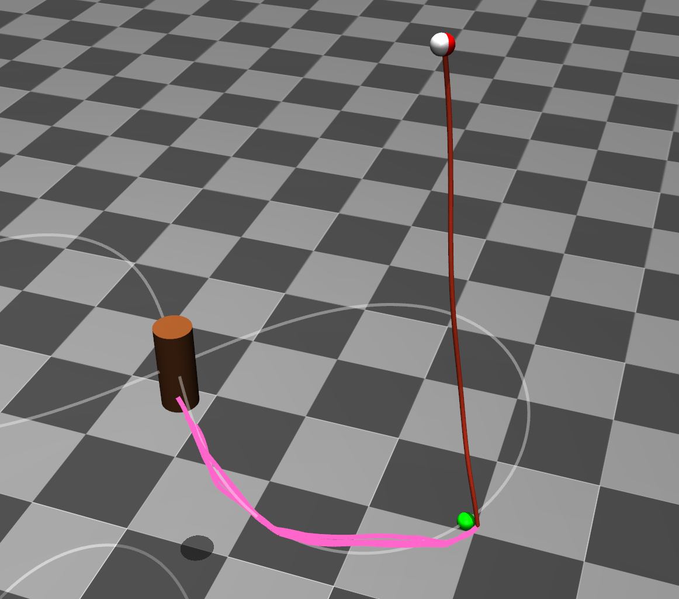
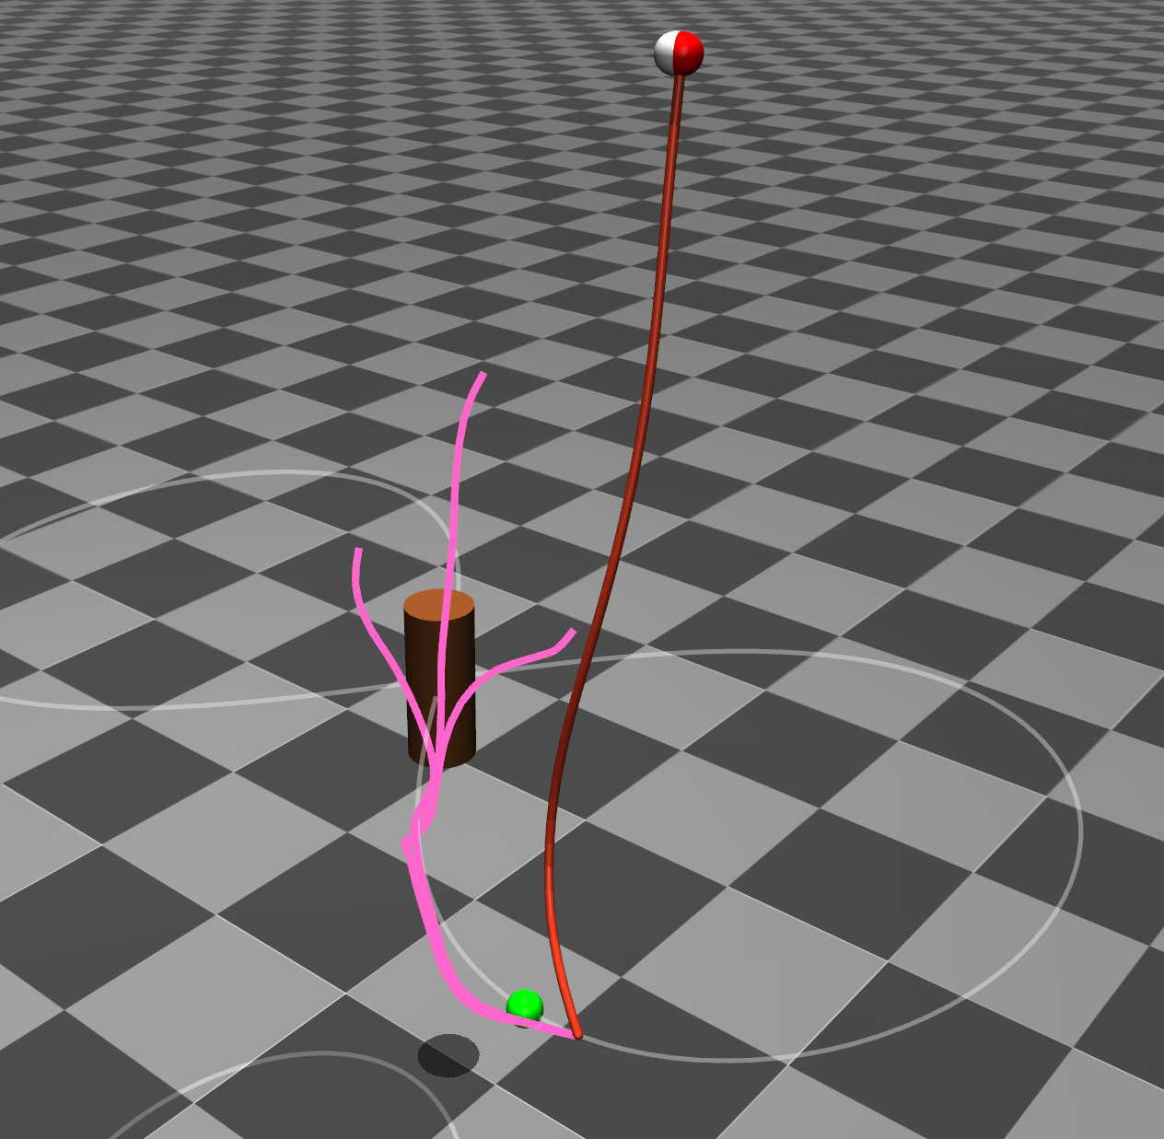
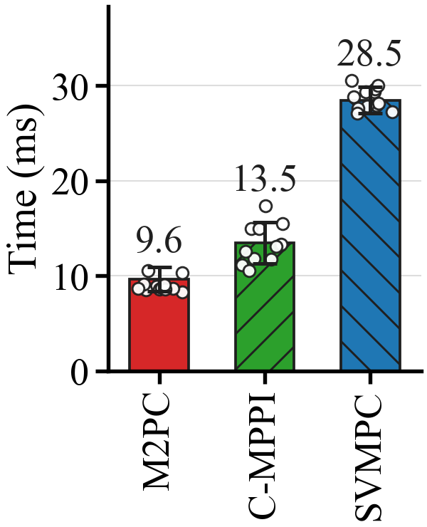

Slide 3
B
D
Multimodal
Emergence
A
C
A
C
B
D
Mode Collapse
A
B
C
D

Slide 4
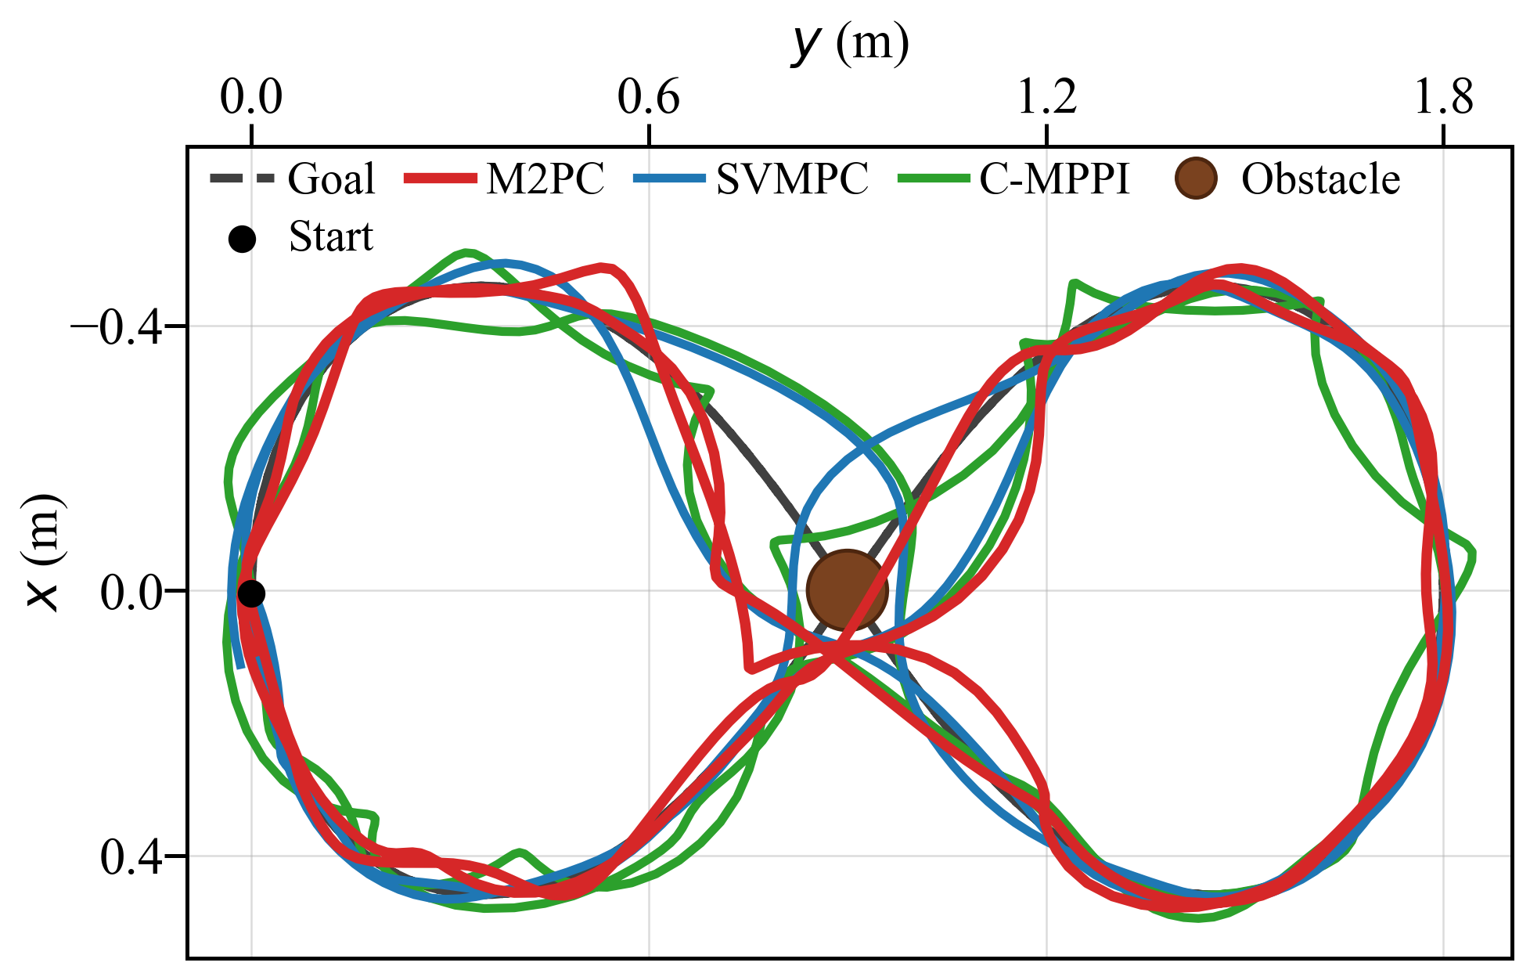
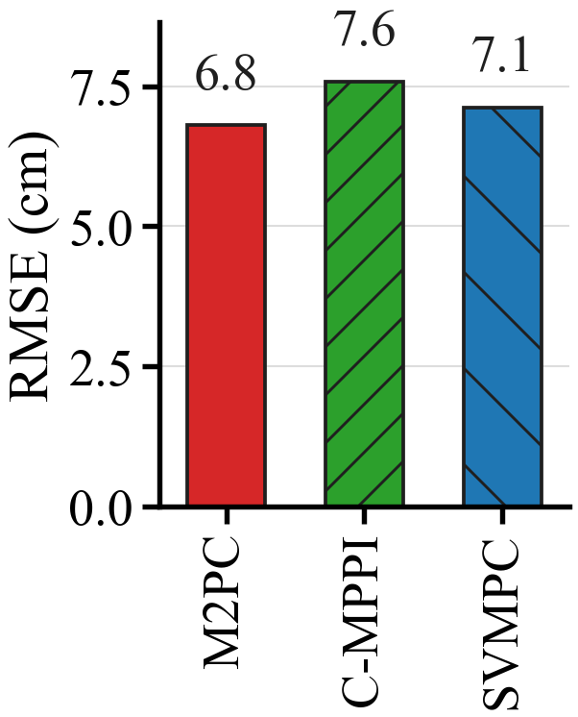
A
C
B
D
A
C
A
B
C
D
Mode Collapse
B
D
Multimodal
Emergence

Slide 5
A
C
B
D
A
C
A
B
C
D
Mode Collapse
B
D
Multimodal
Emergence

